Slide 1
Capstone III Presentation
Project: Student Performance Analysis
Presented by: Cory Lepage

Slide 2
- Dataset -
The dataset consists of 10,000 student records, across six fields, with each record containing information about various predictors and a performance index. The dataset can be found here
Data compiled by Nikhil Narayan.
The most important field used for this analysis is the “Performance Index”, but the other fields will come into the analysis as well. (Fields are: Hours Studied, Previous Scores, Extracurricular Activities, Sleep Hours, Sample Question Papers Practiced, and the Performance Index.)
For reference:
The "Performance Index" is: A measure of the overall performance of each student. The performance index represents the student's academic performance and has been rounded to the nearest integer. The index ranges from 10 to 100, with higher values indicating better performance.

Slide 3
- Research Questions -
There are two questions this analysis will address:
1. What is the relationship between “Sleep Hours” and a student’s performance?
2. Is there a significant difference in the performance of students based on their involvement in extracurricular activities?

Slide 4
- The Hypotheses -
There are two hypotheses in relation to the two research questions:
Hypothesis 1:
Null Hypothesis: There is no correlation between "Sleep Hours" and the "Performance Index"
Alternative Hypothesis: There is a significant correlation between "Sleep Hours" and the "Performance Index“
Hypothesis 2:
Null hypothesis: There is no significant difference in the performance of students who participate in extracurricular activities and those who do not
Alternate Hypothesis: There is a significant difference in the performance of students who participate in extracurricular activities and those who do not.
(I would define "Extracurricular Activities" as optional activities in relation to one's school such as sports, music, clubs, etc.)

Slide 5
- Hypothesis Testing -
The data will be used to test the hypothesis as such:
Visualizations and the Pearson Correlation Coefficient will be used to show the relationship between “Sleep Hours” and the “Performance Index”
Visualizations and an independent-sample t-test will be used to determine if there is a significant difference in performance between students who participate in extracurricular activities and those who do not

Slide 6
- Usefulness of the studies’ findings -
Throughout this look at the data, I had hoped to be able to determine the relative value of certain metrics when it comes to how well a student can perform. I hope students, parents, or related professionals can find value in the exploration of the data when it comes to what variables have the biggest impact on performance.

Slide 7
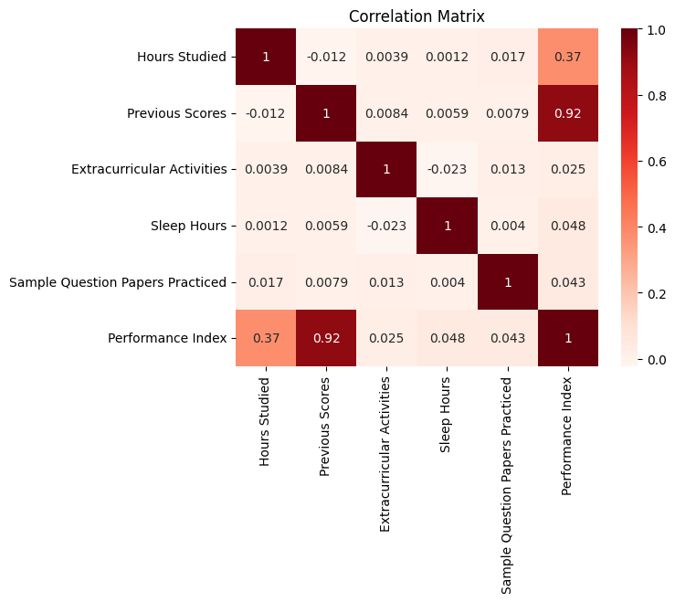
- Hypothesis 1 Analysis -
Pearson R Result (statistic = 0.04810583543435261, P Value = 1.4885369617939595e-06)
Taking a look at the individual Pearson correlation coefficient shows a pretty clear picture when it comes to the relationship between the two variables. It's what I would call a positive relationship, but quite a weak one. As such I find it difficult to accept the alternative hypothesis of there being a "significant" correlation between the two and have a much easier time accepting the null hypothesis: There being essentially no correlation between "Sleep Hours" and "Performance Index“
(Notably, the correlation coefficient between performance and hours studied is much stronger)

Slide 8
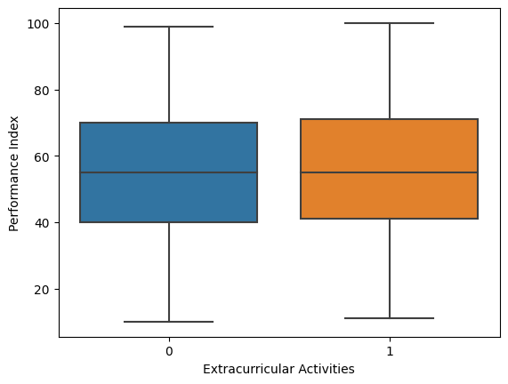
- Hypothesis 2 Analysis -
Splitting the dataset into those that participated in extracurricular activities and those who did not, I ran an independent-samples t-test on the two groups in relation to the “Performance Index”
The sample sizes ended up being 4948 who did participate in extracurricular activities and 5052 who did not.
The sample sizes of the two are close enough to each other in size and large enough in general that I should be able to get a good idea of a significant difference in means by running an independent-samples t-test on the two groups. The results are as follows:
T-test Result (statistic = 2.452987248811042,
P value=0.014184491568554492,
Degrees of Freedom=9998.0)
The difference in means at the 95% confidence interval is between 1.6954076880951225 and -0.18934784706356655.
(In the above chart: 0 = didn’t participate
1 = did participate)
When viewing the results of the independent-samples t-test, though the t-stat is not extremely high, it is above the critical value for a two-tailed test with an alpha of .05 and degrees of freedom being 9998. With the p value being at a sufficiently low enough level we can determine the results of the independent-samples t-test to show that there is indeed a significant difference in the means of the sample sizes.
As such, I find there to be enough evidence to reject the null hypothesis, and say that there is indeed a significant difference in the "Performance Index" between those who participate in extracurricular activities and those who do not.

Slide 9
- Project Summary -
Hypothesis 1: Null Hypothesis Accepted. There is an extremely weak positive correlation between “Sleep Hours” and the “Performance Index”, but not strong enough to be able to call the correlation “Significant”.
Hypothesis 2: Null Hypothesis Rejected. The numbers show that the t-stat is high enough to be labeled as “Significant”, and the corresponding low p value is enough to say that the test has merit in saying so
Project Proposal Link
Colab Notebook Link

Slide 10
- What Does it Mean? -
When looking at the correlation matrix, there appears to be a weak positive correlation between performance, sleep hours, and practice papers completed. There does appear to be a much stronger positive correlation when it comes to performance and hours studied, so I would definitely recommend that as the key variable to be aware of.
As per the testing, there is enough of a difference in the average performance of students (between those who participate in extracurricular activities and those who do not) that I would also give my recommendation to trying out any extracurricular activity that might interest an individual, given the means and opportunity are available.
Thank you for attending my presentation!

